Slide 1



Pandas for Data Analysis

Slide 2
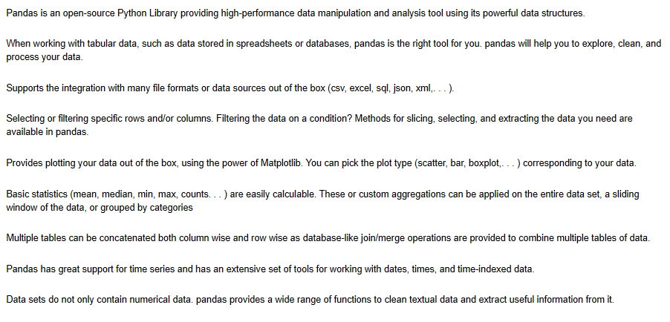
Features of Pandas

